Slide 1


welcome

Slide 2


Roadside Scenario
PRESENTED BY :
Shariful islam sajib sarker id: 2125051016 Mehadi hasan id: 2125051003 Nibir dewan id: 2125051020

Slide 3




introduction
The roadside scenario project aims to simulate a typical scene along a road, showcasing various elements commonly found in such environments.
3

Slide 4


objectives
Objective 1
To create a visually engaging representation of a roadside scene using graphics.h.
Objective 2
To demonstrate the capability of graphics.h in rendering realistic environments.
4

Slide 5


Project Work Description
1
The project utilizes graphics.h library in C++ to draw and animate various components of the roadside scene.
2
Components include roads, vehicles, buildings, trees, and other objects commonly found alongside roads.
3
Different graphical functions are used to create and animate each element, providing a static representation of a roadside scenario.
5

Slide 6

graphical functions
line(): Draws a line between two specified points.
circle(): Draws a circle with a specified center and radius.
rectangle(): Draws a rectangle with specified coordinates.
ellipse(): Draws an ellipse with a specified center and radii.
setcolor(): set color of the line
setfillstyle(): set color of the specified area
floodfill(): select the for coloring
6

Slide 7
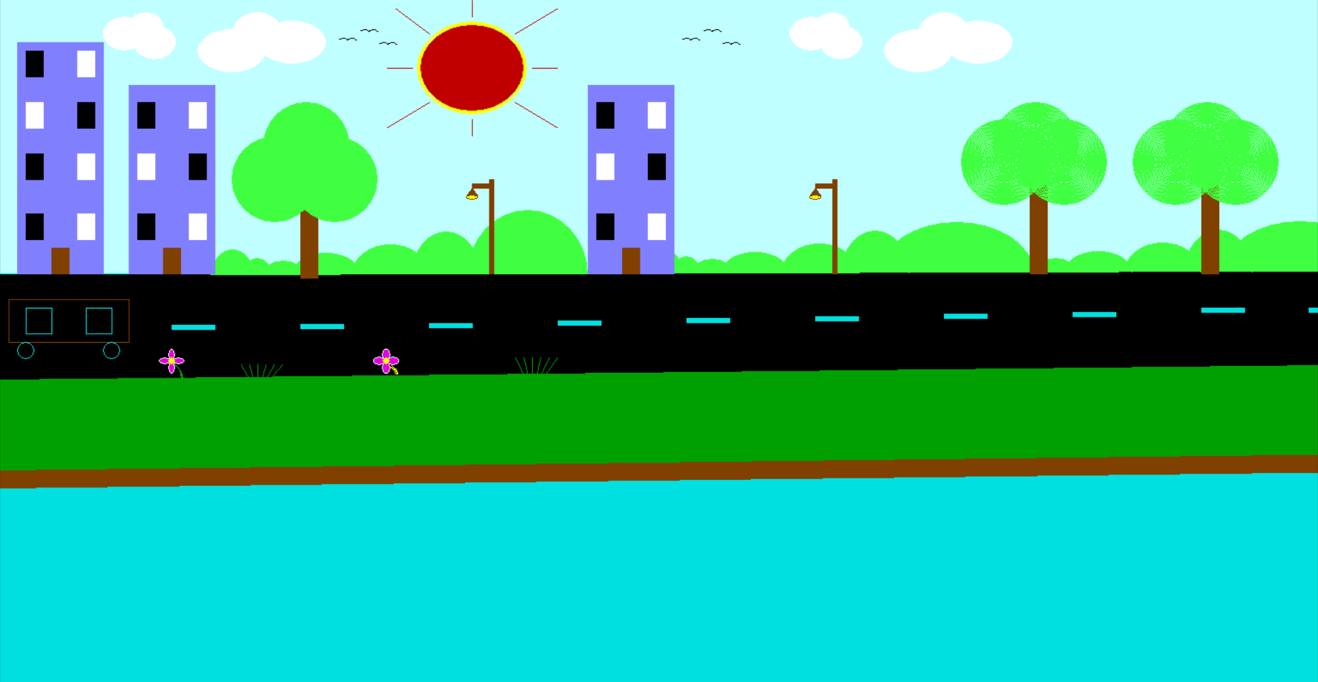
project presentation

Slide 8


Limitations
Limited graphical capabilities:
graphics.h is a basic graphics library and may not support advanced features like realistic textures, shading, or complex animations.
Platform dependency:
The project may only run on systems supporting the BGI graphics driver used by graphics.h, limiting its portability.
8

Slide 9


Conclusion
The roadside scenario project demonstrates the potential of graphics.h library in creating simple yet visually appealing graphical representations.
While it may have limitations, it serves as a starting point for exploring basic graphics programming and understanding fundamental concepts of computer graphics.
9

Slide 10



QUESTION AND ANSWER SESSION
10

Slide 11


THANK YOU

